Slide 1
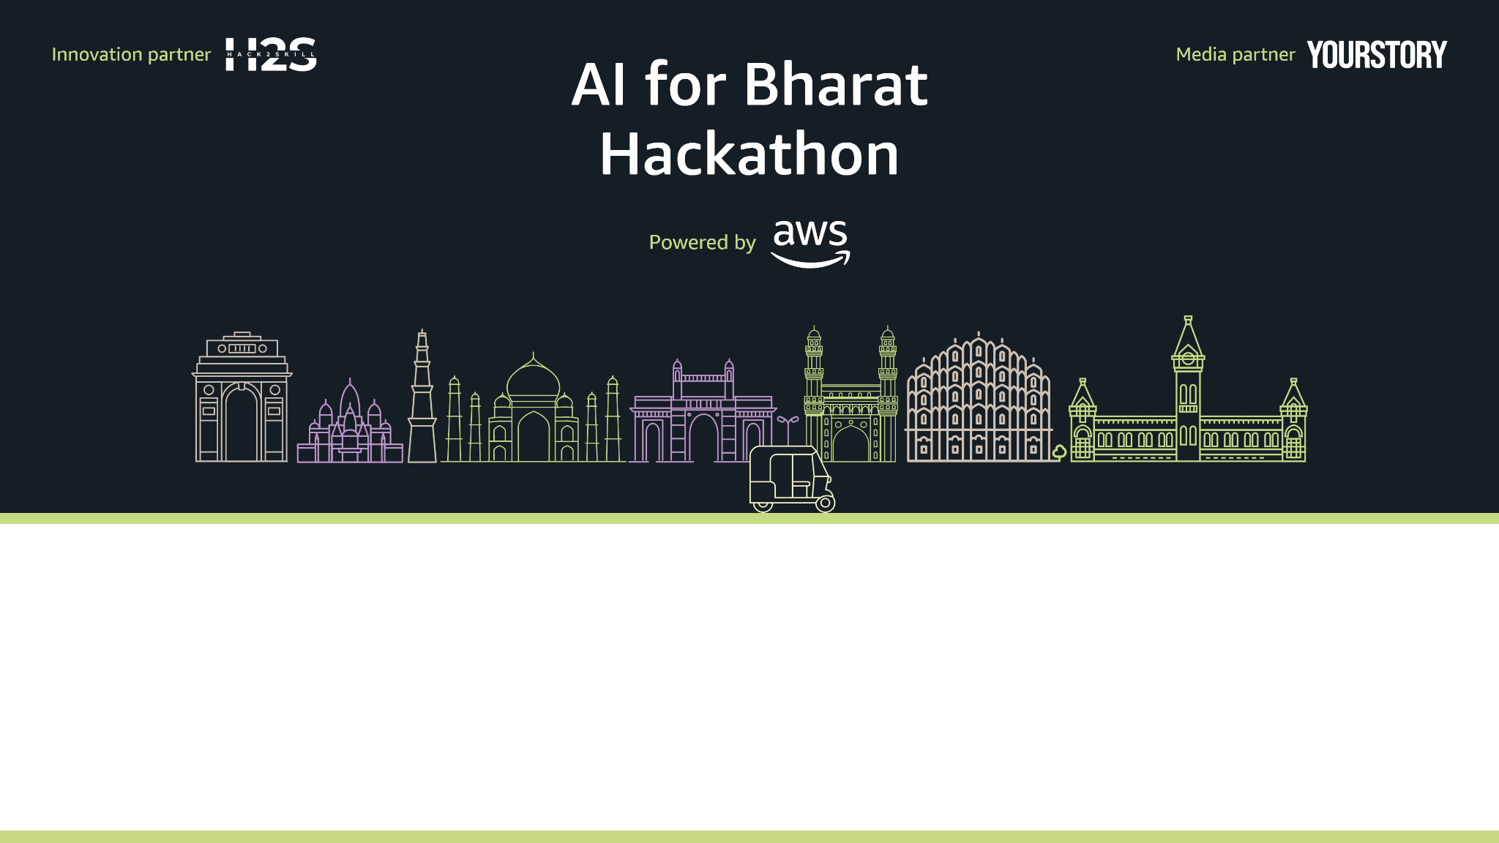
Team Name : Team Unity
Team Leader Name : Bala Murugan R
Problem Statement :AI for Learning & Developer Productivity

Slide 2
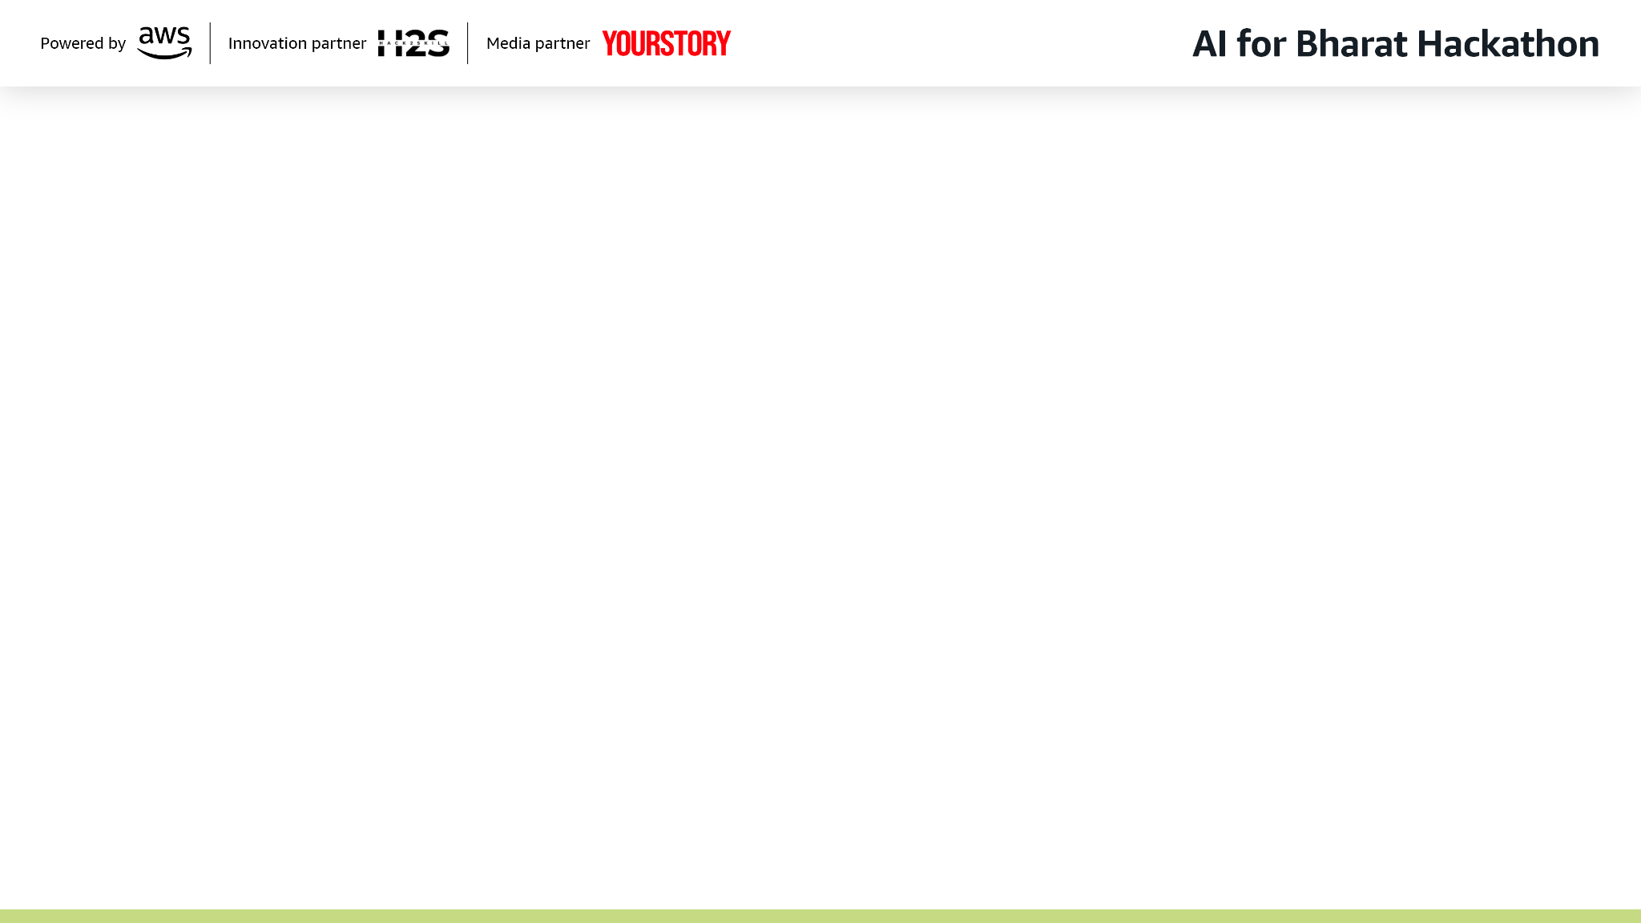
Brief about the Idea:
Multimodal Understanding Beyond Normal AI
The system reads code, screenshots, diagrams, and text together, merging them into one unified context so it fully understands what the user is learning or building.
Real-Time AI Co-Developer & Co-Learner
Instead of just answering prompts, it actively guides the user with step-by-step explanations, debugging, code generation, and instant clarification based on all inputs.
Dynamic Learning Graph for Each User
The AI builds and updates a personalized knowledge graph that tracks concepts learned, gaps, skills, and project progress—then adapts responses instantly.
Actionable, Situational Intelligence
The system doesn’t just explain; it identifies what the user is trying to do from any input and provides the next best action—fix, rewrite, explain, optimize, or teach.

Slide 3
Benefits of Our Solutions:
It combines code, screenshots, diagrams, and text into a single fused understanding—something no existing AI developer tool does.
It solves learning and productivity gaps by analyzing all inputs together and understanding exactly where the user is stuck.
It unifies all forms of input into one intelligent context, giving the system a complete picture of what the user is doing. It acts as a proactive AI mentor that adapts instantly, delivering precise, personalized guidance no other existing tool can match.

Slide 4
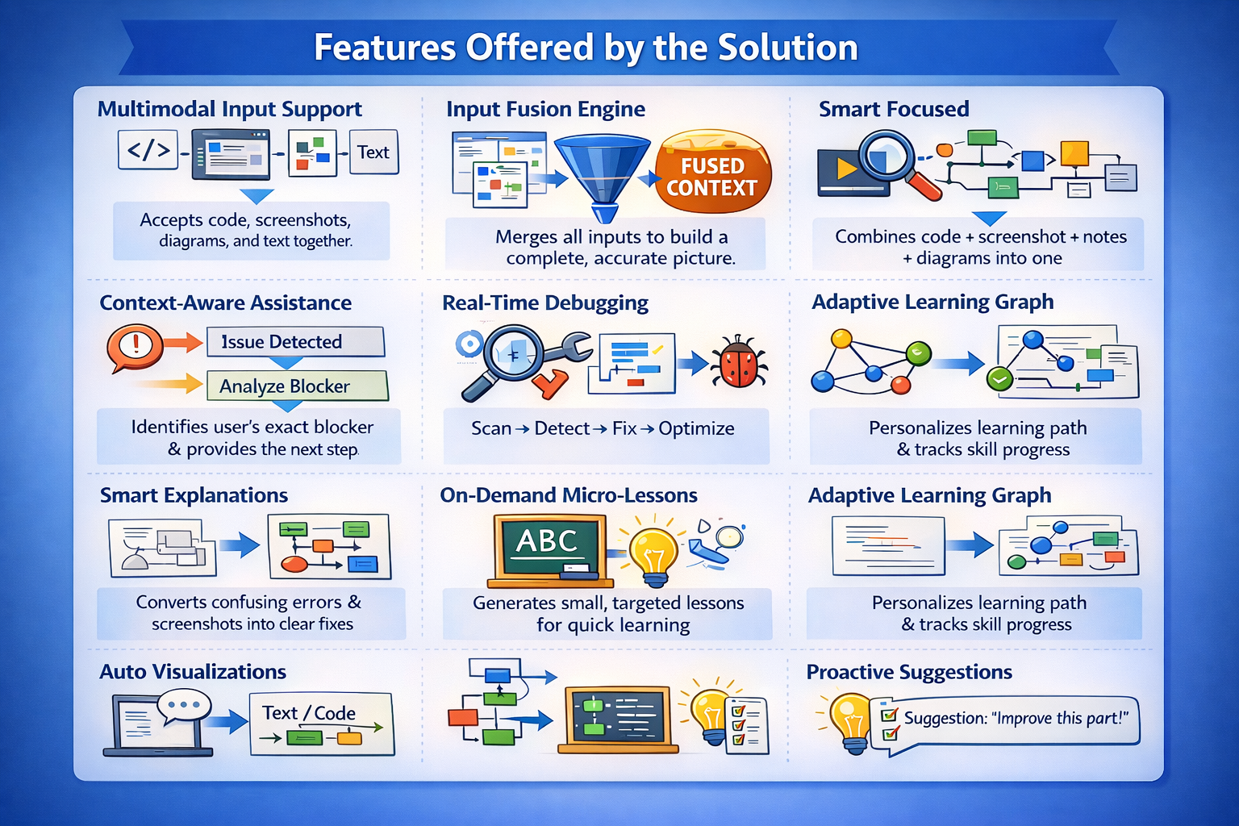

Slide 5
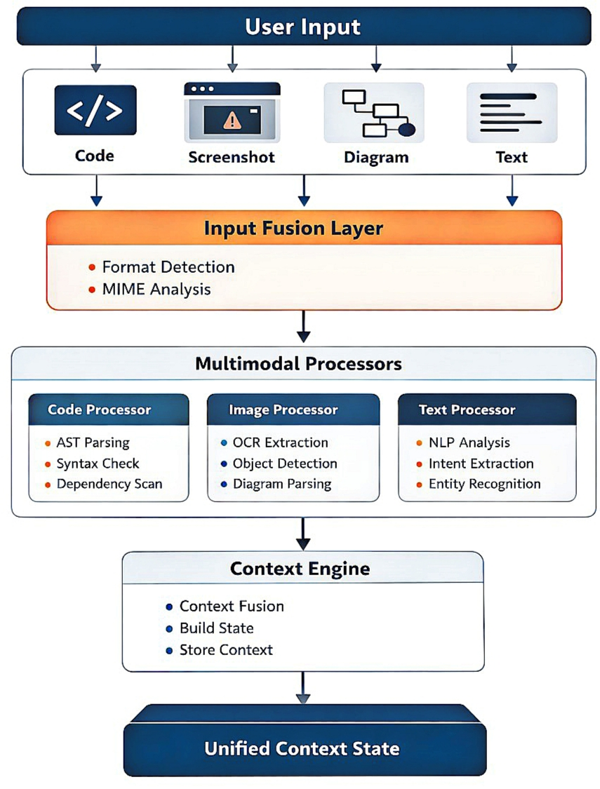
Process Flow Diagram

Slide 6
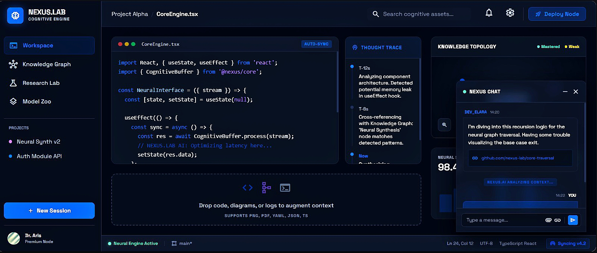
MOCK APPLICATION

Slide 7
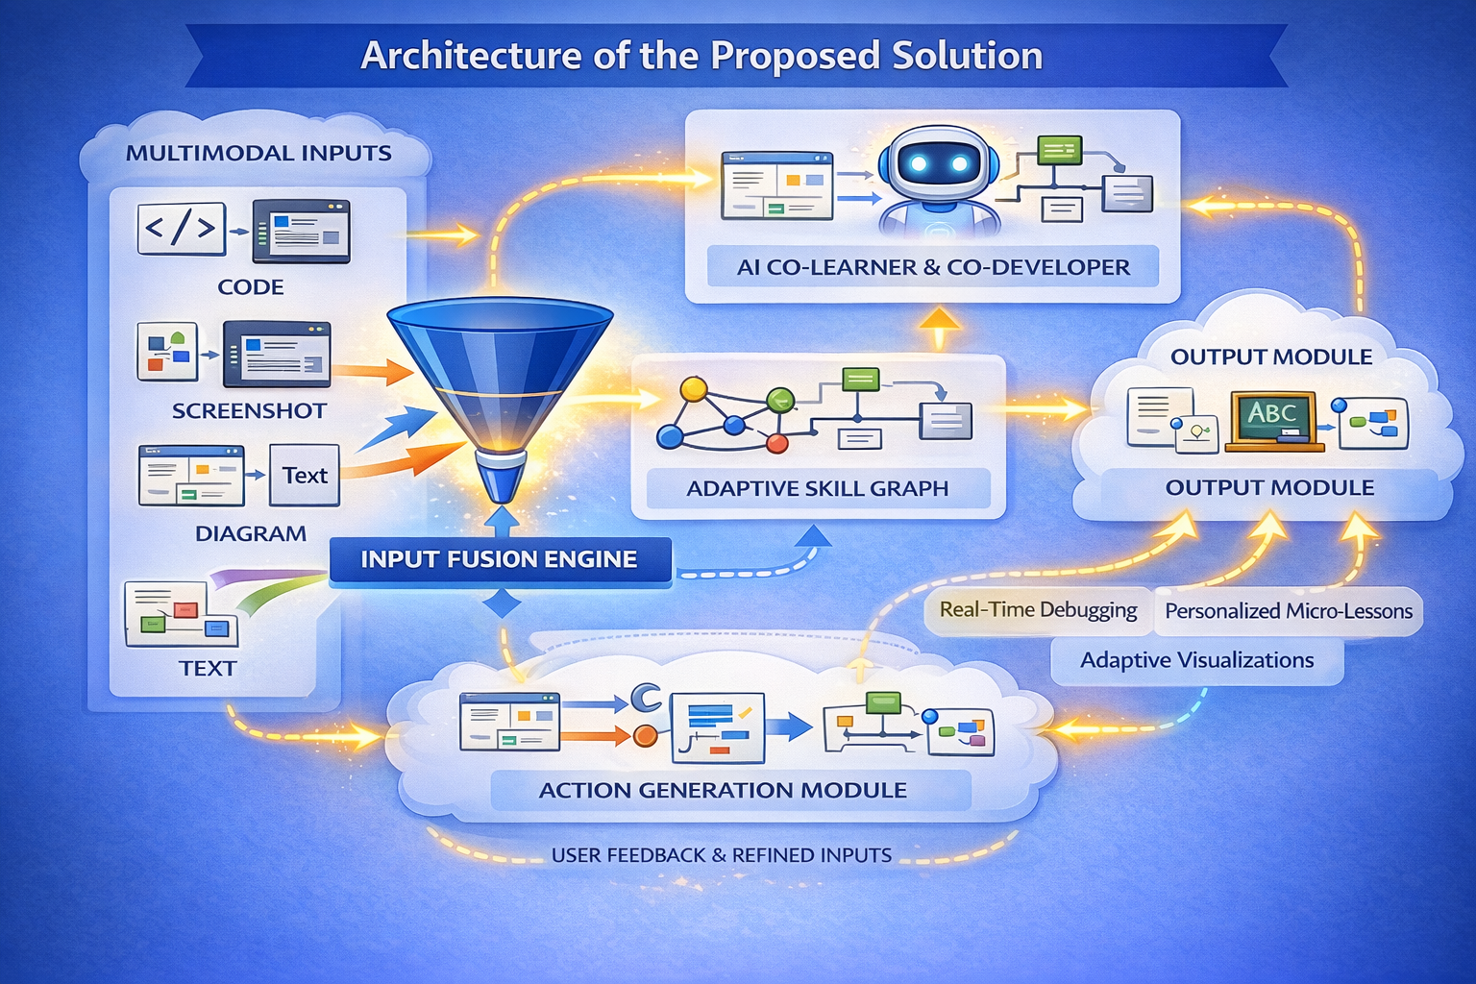

Slide 8
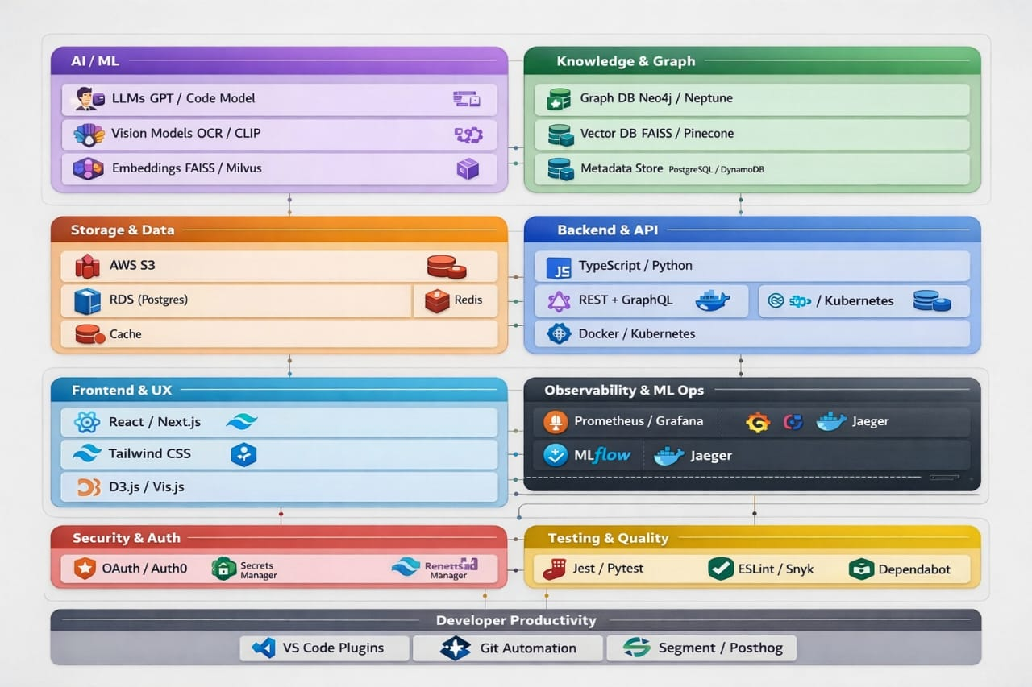
Technologies to be used in the solution:

Slide 9
